Slide 2
We reinvent the Fertility Journey
Notes:
Bea/Nadia

Slide 3
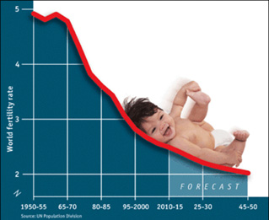
Up to 15% of couples
50M couples worldwide
Notes:
Le -50% n’est pas compris
Preciser
1 couple out of 8
METTRE des sources

Slide 4
The Fertility Journey
Long… time consuming
process
Huge emotional and
financial burden
Notes:
Bien expliquer la pain

Slide 5
The ovarian stimulation
Self-injection at-home
Notes:
IMMA is a comprehensive solution that allows to perform this ovarian monitoring from Home
Our comprehensive system makes it simple to maintain a virtual connection with the women, monitoring their ovarian stimulation including their treatment, providing them with high quality care and the best possible patient experience.
It ‘s a virtuous circle
-A device = a small intravaginal ultrasound device, self-operated, easy to use, ‘one step acquisition’, is associated with a consumable: the device sends automatically the images to the Physician
-Software and AI = 2D+3D reconstruction of the follicle’s volume = the Physician receives the information the way he’s used to and validate the images
-An App = the Mobile app connects the Physician, the women and the clinic
When the Physician receives the images he can therefore:
-Follow up the ovarian stimulation
-adjust the hormonal treatment
-determine the exact day of the follicle pick up

Slide 6
Enables women to perform their own follicle follow up by themselves, for themselves ​ ​in the comfort, safety and intimacy of their home​

Slide 7
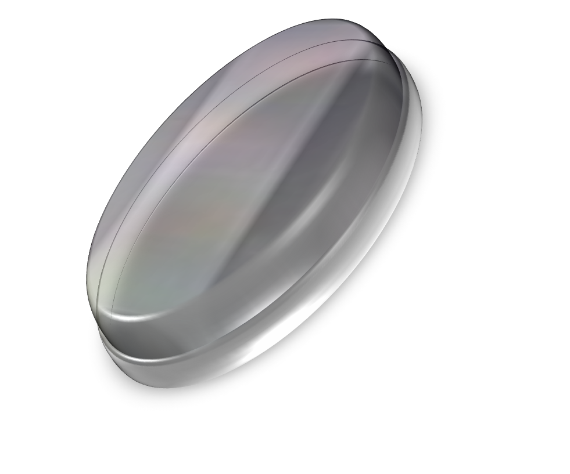
Woman
Ultrasound device
Physician
Updated Treatment
We enable
at-home
Monitoring
Of Ovarian Stimulation
Notes:
IMMA is a comprehensive solution that allows to perform this ovarian monitoring from Home
Our comprehensive system makes it simple to maintain a virtual connection with the women, monitoring their ovarian stimulation including their treatment, providing them with high quality care and the best possible patient experience.
It ‘s a virtuous circle
-A device = a small intravaginal ultrasound device, self-operated, easy to use, ‘one step acquisition’, is associated with a consumable: the device sends automatically the images to the Physician
-Software and AI = 2D+3D reconstruction of the follicle’s volume = the Physician receives the information the way he’s used to and validate the images
-An App = the Mobile app connects the Physician, the women and the clinic
When the Physician receives the images he can therefore:
-Follow up the ovarian stimulation
-adjust the hormonal treatment
-determine the exact day of the follicle pick up
7

Slide 8
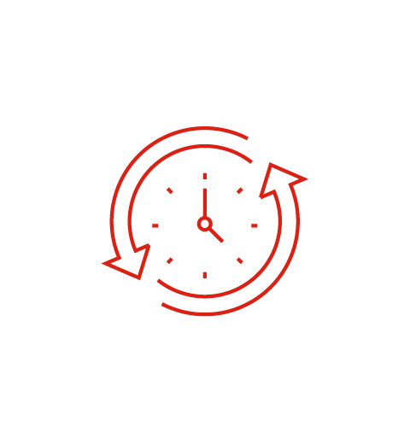
Workflow
Notes:
IMMA is a comprehensive solution that allows to perform this ovarian monitoring from Home
Our comprehensive system makes it simple to maintain a virtual connection with the women, monitoring their ovarian stimulation including their treatment, providing them with high quality care and the best possible patient experience.
It ‘s a virtuous circle
-A device = a small intravaginal ultrasound device, self-operated, easy to use, ‘one step acquisition’, is associated with a consumable: the device sends automatically the images to the Physician
-Software and AI = 2D+3D reconstruction of the follicle’s volume = the Physician receives the information the way he’s used to and validate the images
-An App = the Mobile app connects the Physician, the women and the clinic
When the Physician receives the images he can therefore:
-Follow up the ovarian stimulation
-adjust the hormonal treatment
-determine the exact day of the follicle pick up

Slide 9
Architecture System
Secure server certified for health data
In-house developed algorithm
Acquisition and signal processing
Premium imaging
Performance and accessibility
Probe
with no manipulation
EMR integration of data
Innovation every step of the way

Slide 10
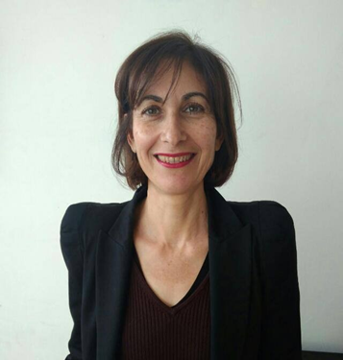
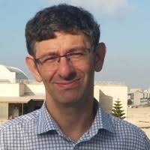
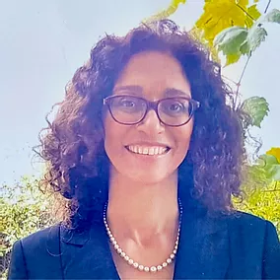
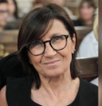
Our Team
BEATRICE CHEMLA
CEO
COMMERCIAL
NADIA PRISANT, MD
CMO
MEDICAL
HS
SYSTEM ARCHITECT
ES
REGULATORY
MW, MD
CLINICAL ULTRASOUND
Notes:
Nadia/Beatrice
Hi I’m Beatrice I worked for many years in the pharma industry as a marketing manager, and then moved to the Market research world
I funded my own company specialzed in market research in healthcare and sold it to a UK company
I was hired to lead their healthcare department
I’m as well a mother of 4 children, I didn’t have to go through this process- - I really enjoy being a parent
I love solving problems and entrepreneurship, I love speaking to people, make them express their pain, and help to solve it
I intent to use my skills to help solve this pain
Hi I am Nadia
I am a fertility specialist with 20 years experience in the field
A dozen publications in internationnal peer reviewed journals
Msc in fertility and experiences in public and private IVF labs
I am also a fertility patient, a traveler of this fertility journey and I know this pain intimately
Advisory board
-IVF Medical Director KOL (USA)
-IVF Medical Director KOL (Europe/Israel)
-Health Insurance expert (USA)
-Strategic Advisor
-Asian serial Entrepreneur
10

Slide 11
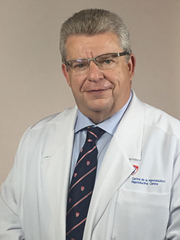
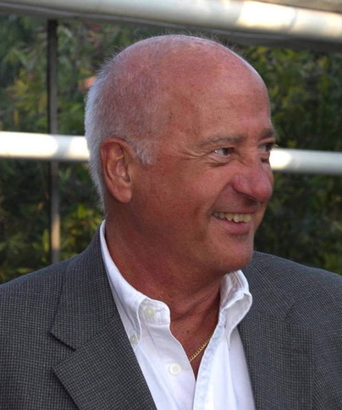
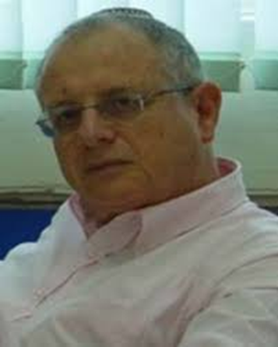
Our advisors
Ex-
PROF. HANANZL HOLZER
FERTILITY
ROBERT BARZELAY
INTERNATIONAL MARKET
ZVI FRIEDMAN
ULTRASOUND IMAGING
ADVISOR
STRATEGY/VP SALES
Notes:
Nadia/Beatrice
Hi I’m Beatrice I worked for many years in the pharma industry as a marketing manager, and then moved to the Market research world
I funded my own company specialzed in market research in healthcare and sold it to a UK company
I was hired to lead their healthcare department
I’m as well a mother of 4 children, I didn’t have to go through this process- - I really enjoy being a parent
I love solving problems and entrepreneurship, I love speaking to people, make them express their pain, and help to solve it
I intent to use my skills to help solve this pain
Hi I am Nadia
I am a fertility specialist with 20 years experience in the field
A dozen publications in internationnal peer reviewed journals
Msc in fertility and experiences in public and private IVF labs
I am also a fertility patient, a traveler of this fertility journey and I know this pain intimately
Advisory board
-IVF Medical Director KOL (USA)
-IVF Medical Director KOL (Europe/Israel)
-Health Insurance expert (USA)
-Strategic Advisor
-Asian serial Entrepreneur

Slide 12
ART Cycles per year

Slide 13
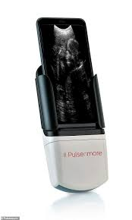
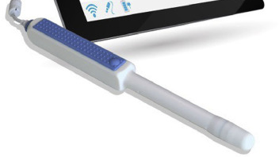
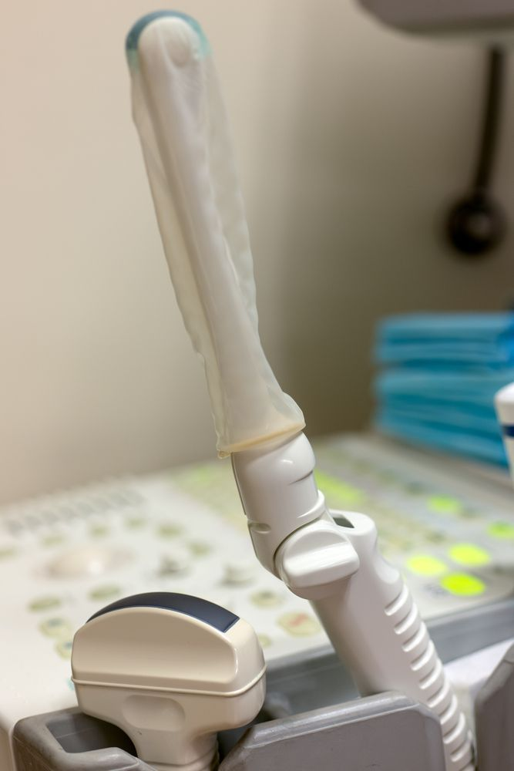
State of the art
Physician experience
No probe manipulation
Current practice

Slide 14
Value Proposition
IVF clinics
B2B
END USER
Number of patients
Standardisation of care
Patient centric care
Premium fee
Time for other tasks
Clinic Positioning
PAYERS
Intimacy
Comfort
Control
Safety
Access
Behavioral Revolution
Stress level
Costs

Slide 15
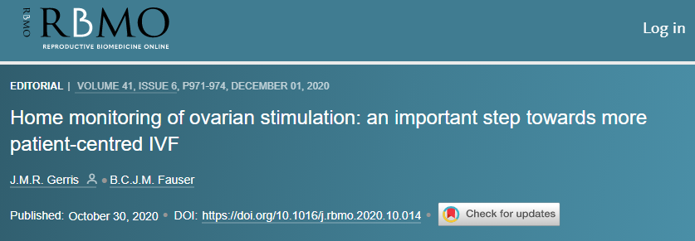
IVF Innovation Ecosystem
Diagnosis & Evaluation
Ovarian stimulation and Monitoring
Oocyte Retrieval
Fertili-
zation
Embryo Transfer
Millions of methods
and companies
Home Monitoring

Slide 16
Thank You
health.imma@gmail.com
Beatrice Chemla
058 422 88 23
Notes:
Largely text – based highlighting 3 key points.
What are the three key points you want investors to remember?
Practice this conclusion ahead of time so
you nail this.

